Slide 1
Deadlocks
MAN, August 2015

Slide 2
Resource
A resource is a commodity needed by a process
printers
Disk
CPU time
Resources can be either:
Serially reusable:
CPU, memory, disk space, I/O devices, files.
acquire → use → release
Consumable:
Produced by a process, needed by a process
messages, buffers of information, interrupts.
create → acquire → use
Resource ceases to exist after it has been used, so it is not released.

Slide 3
Resource
A resource is a commodity needed by a process
printers
Disk
CPU time
Resources can be either:
Serially reusable:
CPU, memory, disk space, I/O devices, files.
acquire → use → release
Consumable:
Produced by a process, needed by a process
messages, buffers of information, interrupts.
create → acquire → use
Resource ceases to exist after it has been used, so it is not released.

Slide 4
Resource
Resources can be either:
shared among several processes
dedicated exclusively to a single process

Slide 5
Resource
Resources can also be either:
Preemptable:
can be taken away from a process with no ill effects
e.g., CPU, Memory
Non-preemptable:
will cause the process to fail if taken away
e.g., CD recorder, Printer.
Generally Deadlocks involve exclusive access to non-premtable resources

Slide 6
Resources
Sequence of events required to use a resource
request the resource
use the resource
release the resource
If requested resource is not available the requesting process is blocked

Slide 7
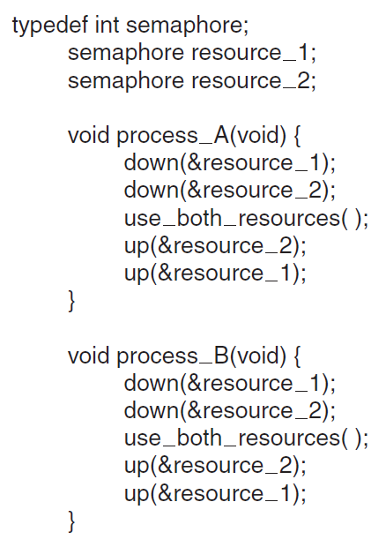
Resource Access Control Using Semaphores

Slide 8
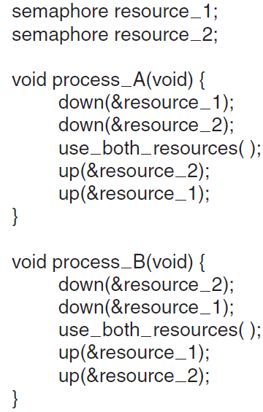
Resource Access Control Using Semaphores

Slide 9
Introduction to Deadlocks
Formal definition : A set of processes is deadlocked if each process in the set is waiting for an event that only another process in the set can cause
Usually the event is release of a currently held resource
This kind of deadlock is called Resource Deadlock

Slide 10
Introduction to Deadlocks
None of the deadlocked processes can …
run
release resources
be awakened
Permanent blocking
A law passed by the Kansas legislature early in the 20th century
“When two trains approach each other at a crossing, both shall come to a full stop and neither shall start up again until the other has gone.”

Slide 11
Four Conditions for Deadlock
Mutual exclusion condition
each resource assigned to exactly 1 process or is available
Hold and wait condition
process holding resources can request additional resources
No preemption condition
previously granted resources cannot forcibly taken away
Circular wait condition
must be a circular chain of 2 or more processes
each is waiting for resource held by next member of the chain
T₁ is waiting for a resource that is held by T₂
T₂ is waiting for a resource that is held by T₃
…
T_{n} is waiting for a resource that is held by T₁

Slide 12
Four Conditions for Deadlock
The fourth condition is a potential consequence of the first three
Given that the first three conditions exist, a sequence of events may occur that lead to an unresolvable circular wait.
The unresolvable circular wait is in fact the definition of deadlock.
The circular wait listed as condition 4 is unresolvable because the first three conditions hold.
Thus, the four conditions, taken together, constitute necessary and sufficient conditions for deadlock
If one of them is absent, no deadlock is possible

Slide 13
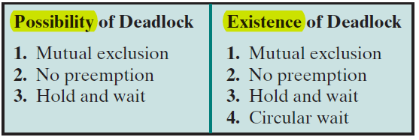
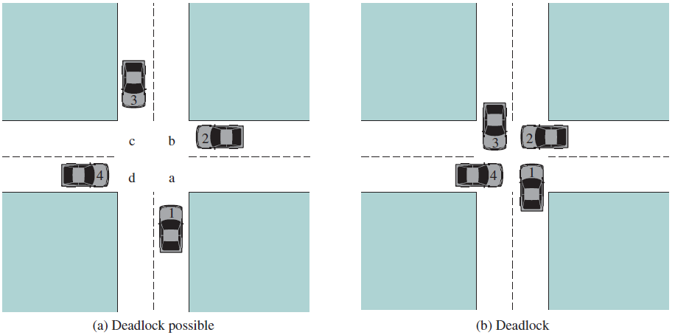

Slide 14
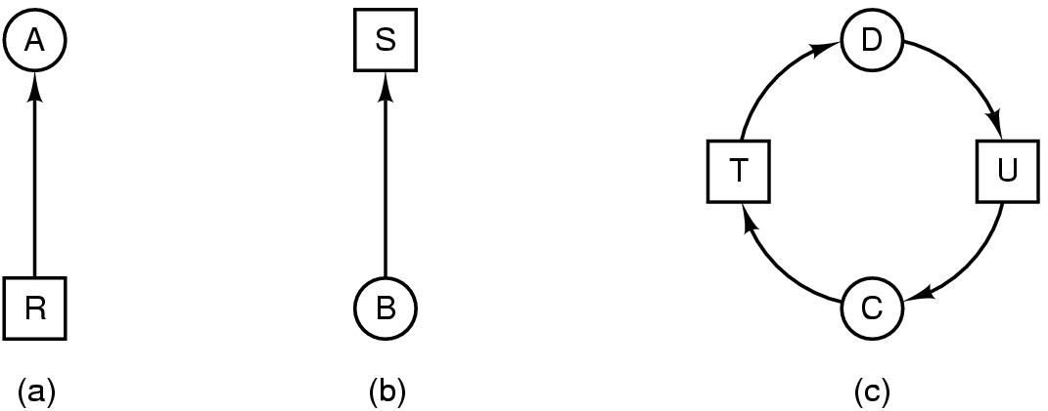
Deadlock Modeling
Modeled with directed graphs
2 types of nodes: process , resource
edges
R ---> A ;resource R assigned to process A
B ----> S ;process B is blocked waiting for resource S
process C and D are in deadlock over resources T and U

Slide 15
Deadlock Modeling
A cycle in the graph means that there is a deadlock involving the processes and resources in the cycle (assuming that there is one resource of each kind).
In this example, the cycle is C–T–D–U–C.

Slide 16
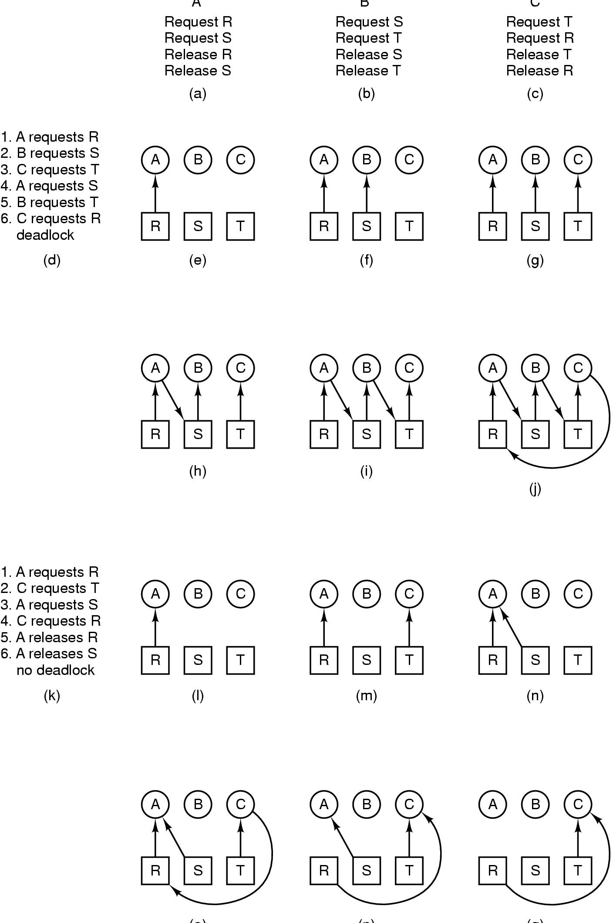
Deadlock Modeling
A B C
How deadlock occurs

Slide 17
Deadlock Modeling
(o) (p) (q)
How deadlock can be avoided

Slide 18
Deadlock Modeling
resource graphs are a tool for finding if a given request/release sequence leads to deadlock.
We just carry out the requests and releases step by step, and after every step check the graph to see if it contains any cycles.
Although we used resource graphs for the case of a single resource of each type
Resource graphs can also be generalized to handle multiple resources of the same type

Slide 19
Dealing with Deadlocks
Strategies for dealing with Deadlocks
Just ignore the problem altogether
detection and recovery
Let deadlocks occur, detect them, and take action.
Dynamic avoidance
careful resource allocation
Prevention
negating one of the four necessary conditions

Slide 20
The Ostrich Algorithm
The simplest approach
Don’t do anything, simply restart the system
Rational:
Deadlock prevention, avoidance or detection/recovery algorithms are expensive
if deadlock occurs only rarely, it is not worth the overhead to implement any of these algorithms.
UNIX, Linux and Windows takes this approach
It is a trade off between
convenience
correctness

Slide 21
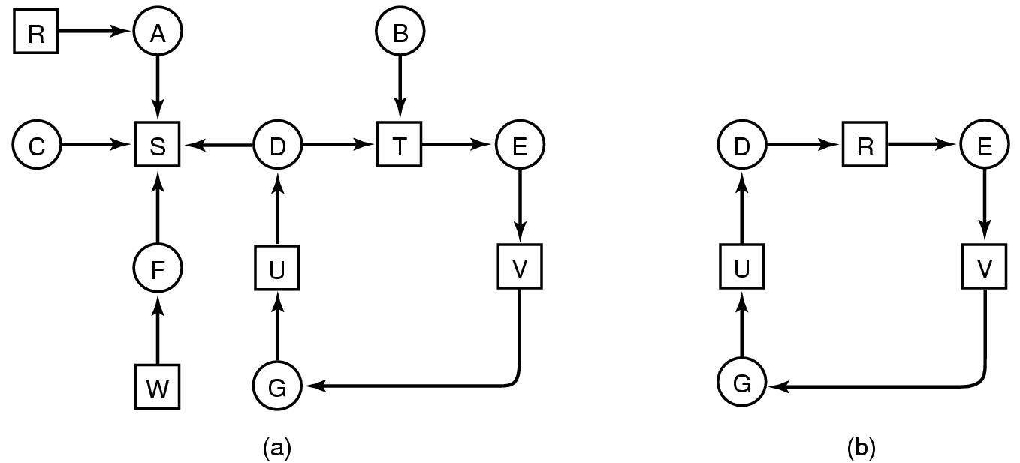
Detection with One Resource of Each Type
Note the resource ownership and requests
A cycle can be found within the graph, denoting deadlock

Slide 22
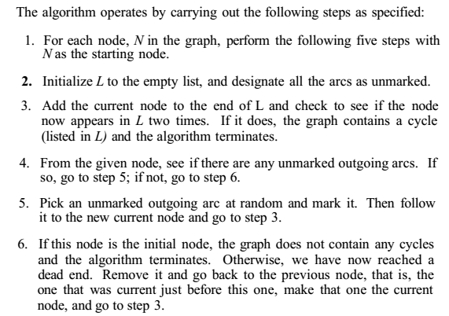
Detection with One Resource of Each Type

Slide 23
Detection with One Resource of Each Type
The order of processing the nodes is arbitrary
let us just inspect them from left to right, top to bottom
starting at R, then successively A, B, C, S, D, T, E, F…
If we hit a cycle, the algorithm stops.

Slide 24
Detection with One Resource of Each Type
From B we continue to follow outgoing arcs until we get to D, at which time L = [B, T, E, V, G, U, D].
Now we must make a random choice
If we pick S we come to a dead end and backtrack to D
The second time we pick T
Update L to be [B, T, E, V, G, U, D, T ]

Slide 25
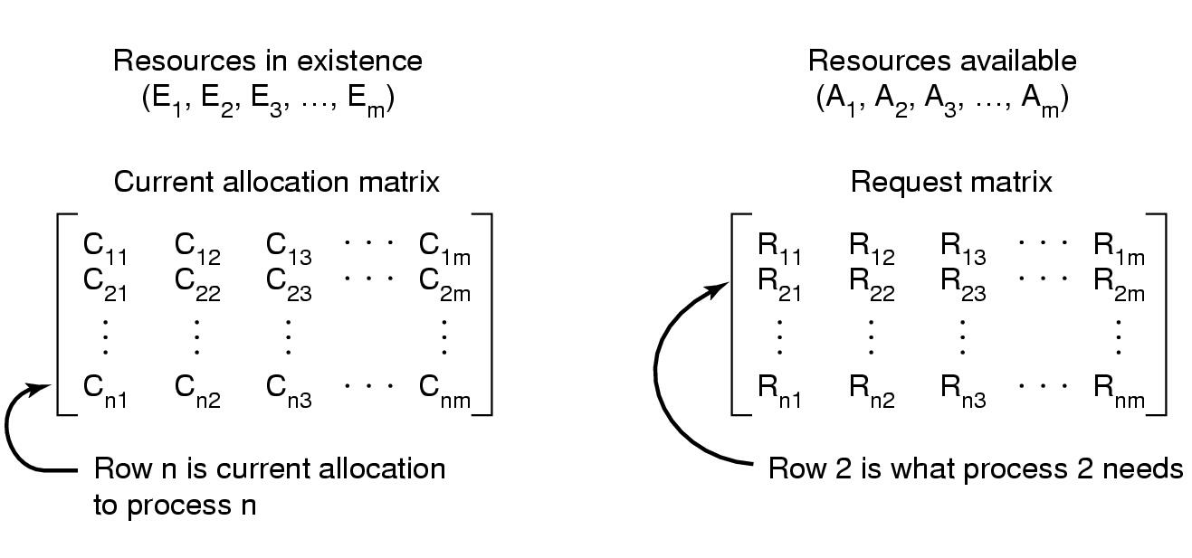
Detection with Multiple Resource of Each Type
Data structures needed by deadlock detection algorithm

Slide 26
Detection with Multiple Resource of Each Type
Invariant: ∑_{1≤i≤n}C_{ij} + A_{j} = E_{j}
Assumption
Worst case scenario
Algorithm:
Look for an unmarked process, P_{i}, for which the i-th row of R is less than or equal to A
If such a process is found, add the i-th row of C to A, mark the process, go to step 1
If no such process exists, terminate
After termination, all the unmarked processes are deadlocked

Slide 27
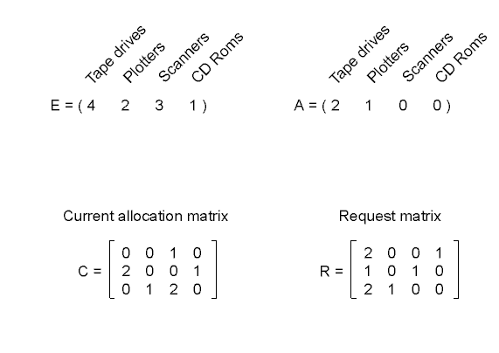
Detection with Multiple Resource of Each Type
An example for the deadlock detection algorithm

Slide 28
When to run Detection Algorithm?
Every time a resource request is made
Can detect deadlock as early as possible
Expensive in terms of CPU time
When CPU utilization drops below a threshold
If enough processes are deadlocked there will be few runnable processes

Slide 29
Recovery from Deadlock
Recovery through preemption
Take a resource temporarily from the current owner process
Manual intervention may be needed
Depends on nature of the resource
Recovery through rollback
Checkpoint a process periodically
use this saved state
Rollback a process to an earlier time if needed

Slide 30
Recovery from Deadlock
Recovery through killing processes
Crudest but simplest way to break a deadlock
Kill one of the processes in the deadlock cycle
The other processes get its resources
Alternatively, one of the processes not deadlocked may be killed
Choose process for killing that can be rerun from the beginning with no ill effect

Slide 31
Deadlock Avoidance
So far we assumed that a process asks for all the resources it needs at once
In most systems, resources are requested one at a time
To avoid deadlock the system must be able to decide
Whether granting a request is safe or not
Only make the allocation when it is safe
But we need some information in advance

Slide 32
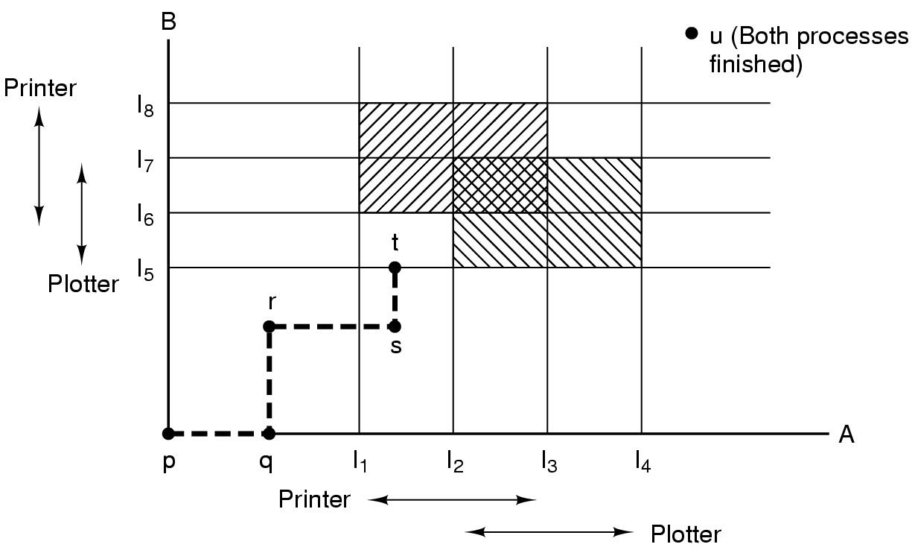
Concept of Safety
Two process resource trajectories

Slide 33
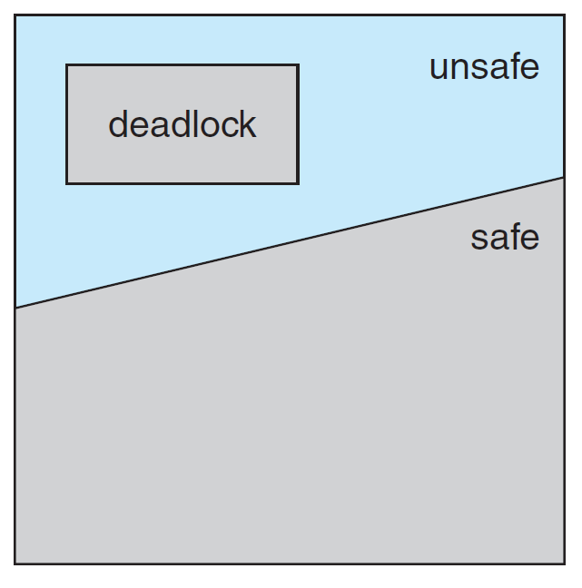
Safe and Unsafe States
A state is safe if
there is some scheduling order in which
every process can complete even if
all of them suddenly request their maximum number of resources immediately
An unsafe state is not a deadlocked state
Safe Vs. Unsafe
A safe state guarantees that all processes will finish

Slide 34
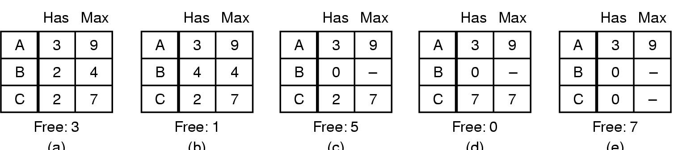
Safe and Unsafe States
One Resource Case
Total 10 instances available
(a) (b) (c) (d) (e)
Demonstration that the state in (a) is safe

Slide 35
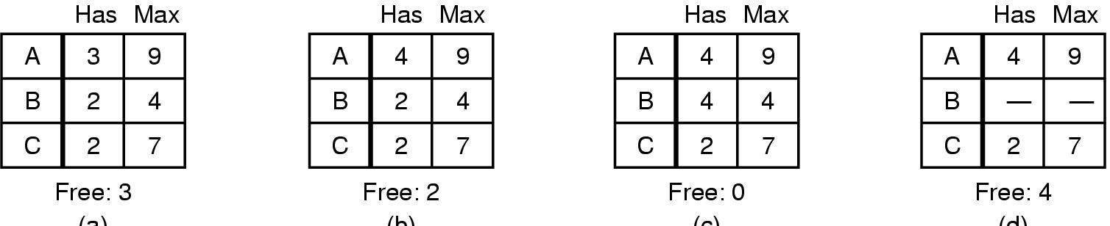
Safe and Unsafe States
(a) (b) (c) (d)
Demonstration that the sate in (b) is not safe
The allocation decision that moved the system from (a) to (b) went from a safe state to unsafe state
NOTE: An unsafe state is not a deadlocked state
Safe Vs Unsafe
A safe state guarantees that all processes will finish

Slide 36
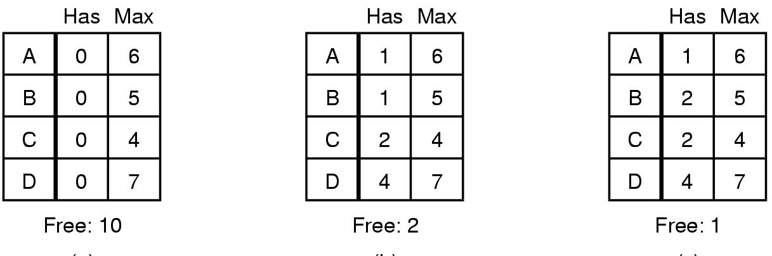
The Banker's Algorithm for a Single Resource
(a) (b) (c)
Three resource allocation states
safe
safe
unsafe

Slide 37
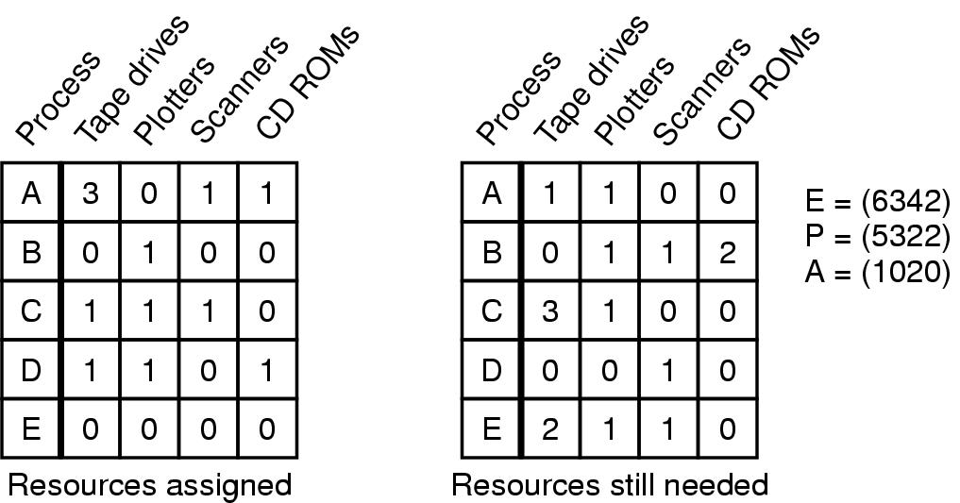
Banker's Algorithm for Multiple Resources
Example of banker's algorithm with multiple resources

Slide 38
Banker's Algorithm Steps:
Look for a row, R, whose unmet resource needs are all smaller than or equal to A
Mark the process as terminated and add all its resources to A
Repeat steps 1 and 2 until
either all processes are terminated in which case the initial state was safe
or no process is left whose needs can be met in which case the initial state was unsafe

Slide 39
Banker's Algorithm: Disadvantages
Theoretically wonderful but in practice essentially useless
Why?
Processes rarely know in advance what there maximum resource needs will be

